Slide 1
Introduction to GAMMs
Evelien Heyselaar

Slide 2

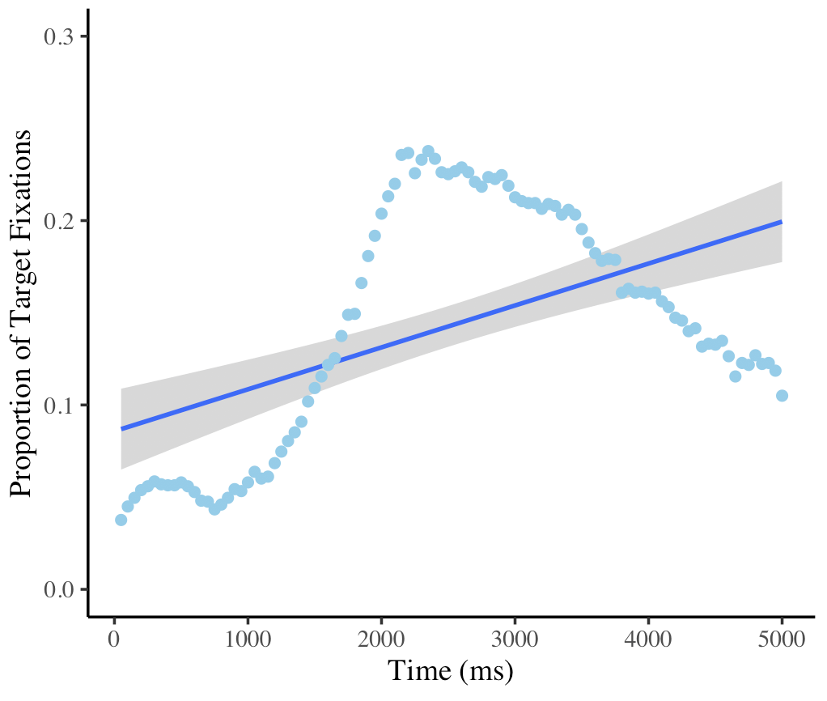
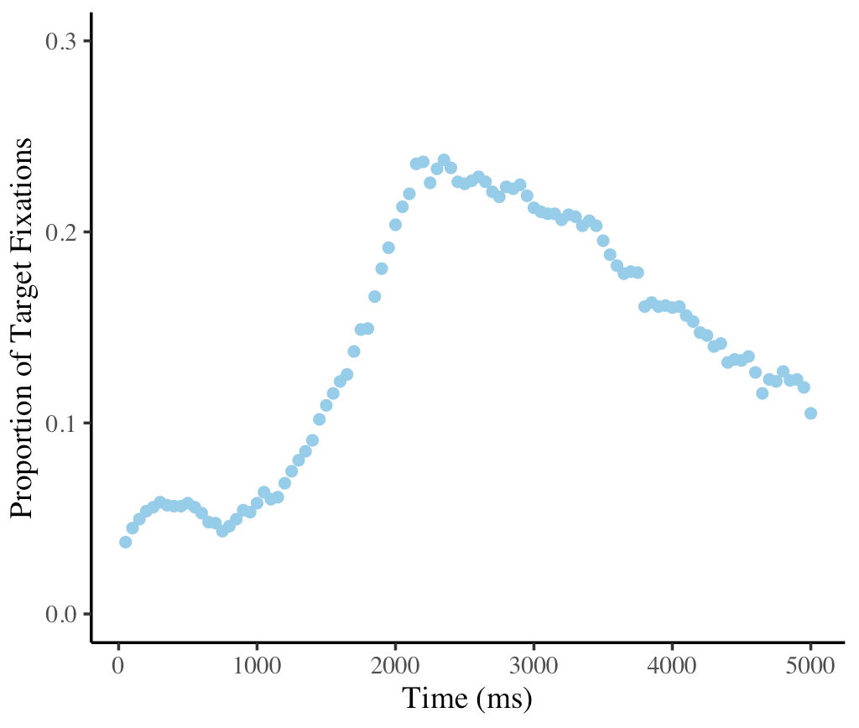
Mixed Effects Models
lme4 package
Linear

Slide 3

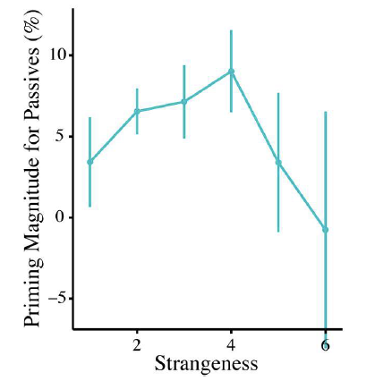
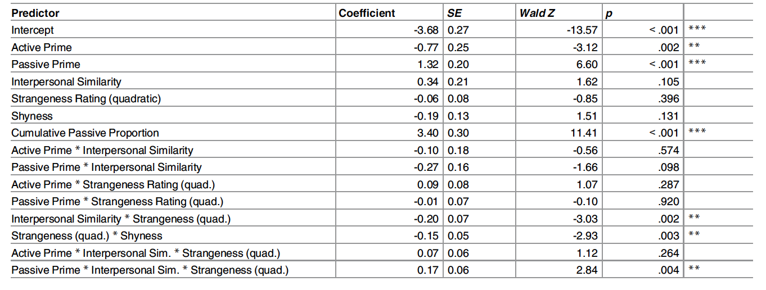
Mixed Effects Models
glmer(Priming~(strangeness)^2 + (1|Subject) + (1|item)
Heyselaar et al., (2017)

Slide 4
GAMM
Generalized Additive Mixed (Effects) Model
Tests every type of correlation, and even tells you what it is in the output file (we’ll get to that in a second)

Slide 5

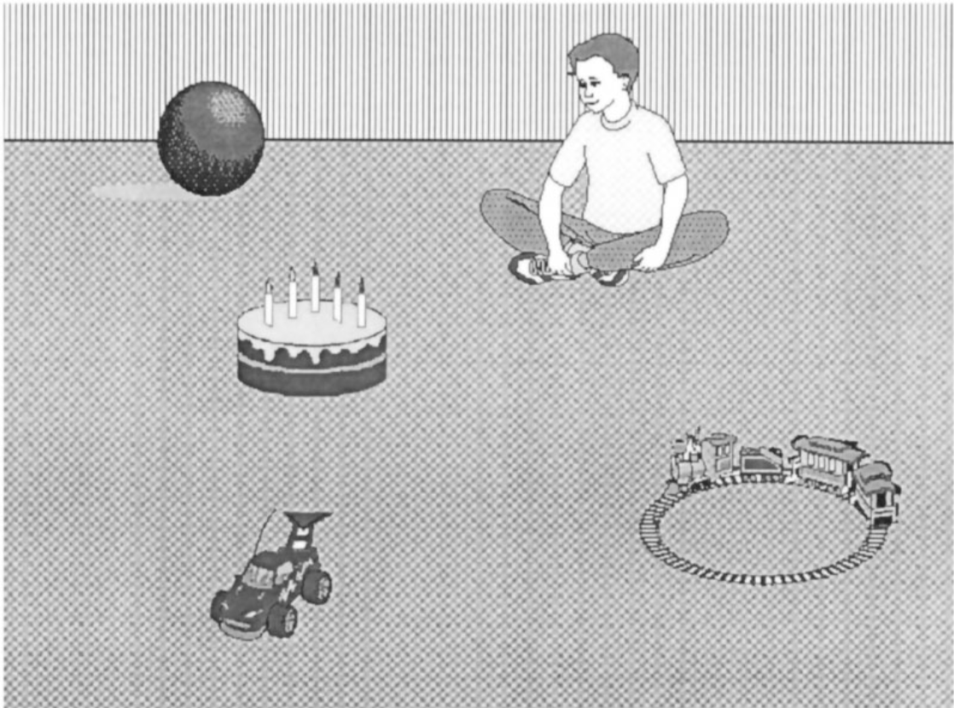
Eye-tracking Experiment
Altmann & Kamide (1999)

Slide 6
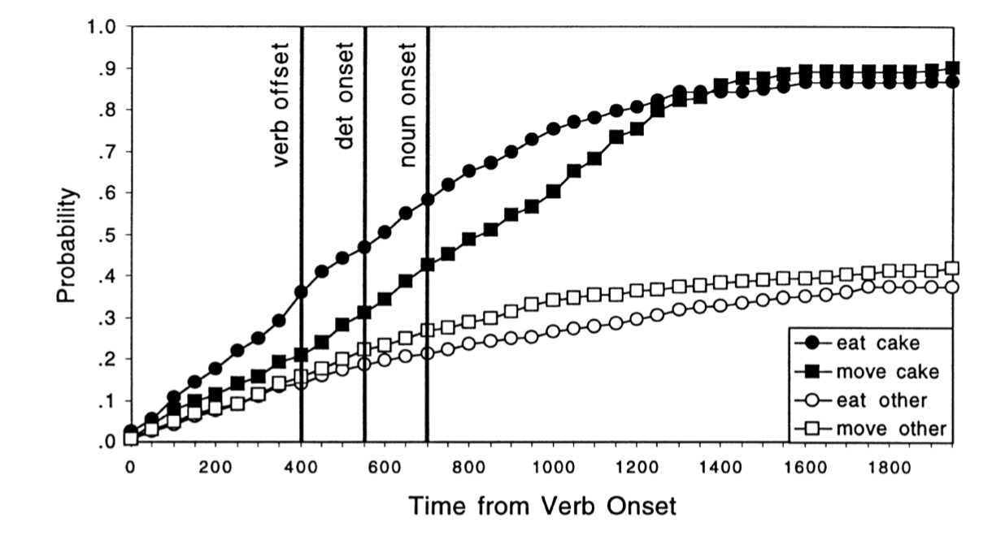
Visual World Paradigm
Altmann & Kamide (1999)

Slide 7
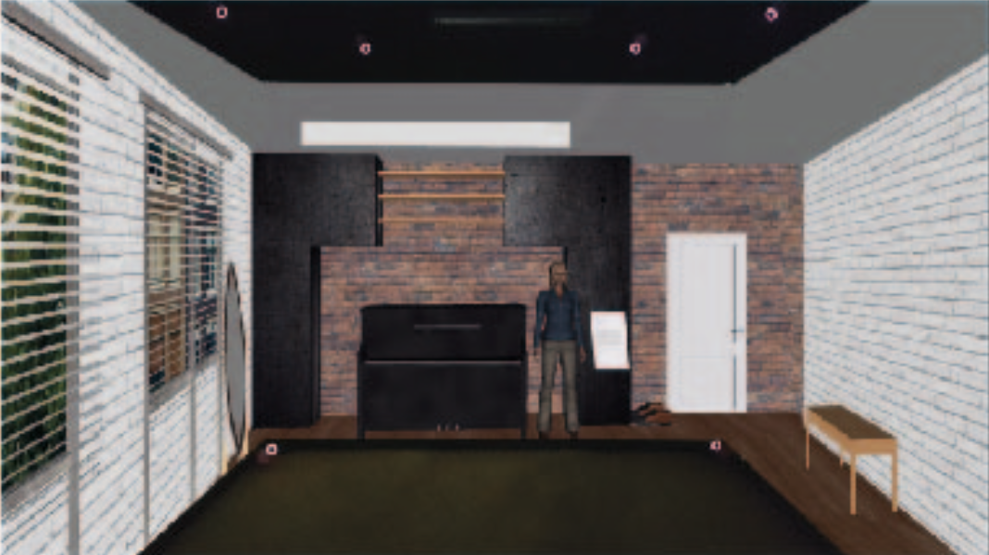
Visual World Paradigm (VR Edition)
N = 20 (13 female, MAge: 22.8 years)
8 scenes (living room, kitchen, bathroom, etc.)
64 sentences per participant (8 per scene: 50% restrictive)

Slide 8
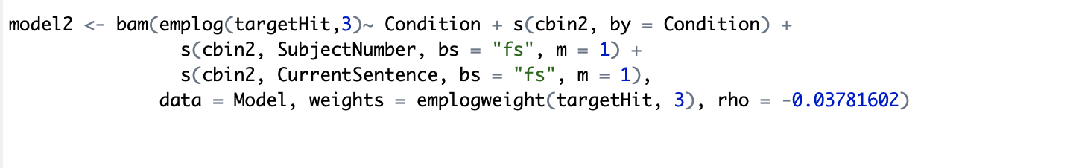
gam vs bam : basically the same. The only major difference is that bam is made to handle bigger data sets (N > 10,000)
If Condition was continuous, then we would write this interaction as:
ti(cbin2, Condition)
Smooth Terms
s() :
for modeling a 1-dimensional smooth, or
for modeling isotropic interactions (variables are measured in same units and on same scale)
te(): for modeling 2- or n-dimensional interaction surfaces of variables that are not isotropic. Includes ‘main’ effects.
ti(): for modeling 2- or n-dimensional interaction surfaces that do not include the ‘main effects’.
with factor include intercept difference:
Group + s(Time, by=Group)
with ordered factor include intercept difference and reference smooth:
Group + s(Time) + s(Time, by=Group)
with binary predictor include reference smooth:
s(Time) + s(Time, by=IsGroupX)

Slide 9
random intercepts adjust the height of other model terms with a constant value:
s(Subject, bs=“re")
random slopes adjust the slope of the trend of a numeric predictor:
s(Subject, Time, bs=“re")
random smooths adjust the trend of a numeric predictor in a nonlinear way:
s(Time, Subject, bs="fs", m=1)
The model treats an entire time series as 1 continuous trial. This is not always the case. Use start_value_rho to determine the autocorrelation (AR1) correction

Slide 10
Resources
https://jacolienvanrij.com/Tutorials/GAMM.html
Porretta, V., Kyröläinen, A. J., van Rij, J., & Järvikivi, J. (2017, June). Visual world paradigm data: From preprocessing to nonlinear time-course analysis. In International Conference on Intelligent Decision Technologies (pp. 268-277). Springer, Cham.

